Slide 1
Does Poor Air Quality Increase Asthma Rates?
A case study on counties of Minnesota and Massachusetts
Name: Anthony Zhong
University of Hawaii at Manoa – ECON 429
Instructor: Ashley Lowe Mackenzie

Slide 2
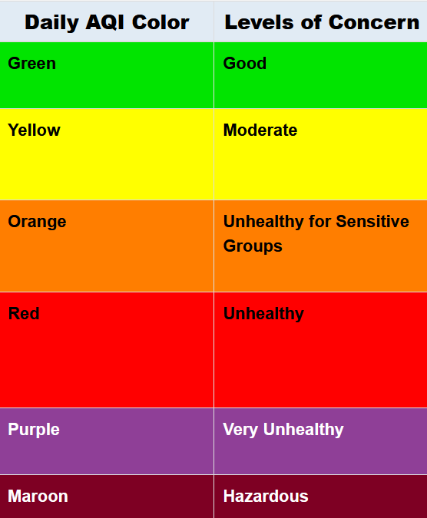
Methodology: The AQI Index
EPA Standard: Measures outdoor air quality by concentration of pollutants
Scale: 0-500 (higher = higher health risk)
All Pollutants:
Ground-level Ozone (O3)
Particle pollution (PM2.5 & PM10)
Others (CO, SO, & NO2)
Categories:
0-50: Good / Little Risk
51-100: Moderate Risk
>100: Unhealthy
Image Credit: Airnow.gov

Slide 3


Study Focus
Goal: Explore the link between air quality and asthma outcomes
Location: Massachusetts & Minnesota
Data: County-level, age-adjusted rates (ages 5 - 64), pop-adjusted rates (per 100k), 3-years span (2016-2019)
Asthma Outcomes (Y₁, Y₂):
Asthma Hospitalizations: Life-threatening asthma flares
ER Visits: Sudden asthma shocks
1st image: Massachusetts
2nd image: Minnesota
Image Credit: Google Image

Slide 4
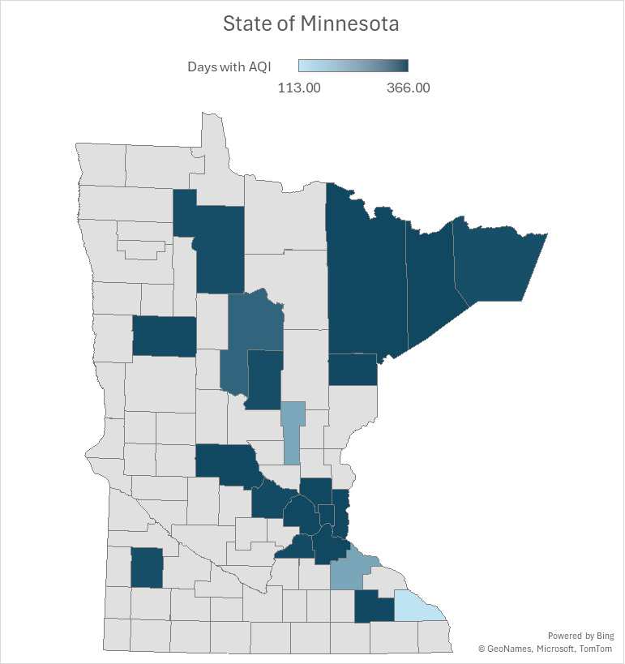
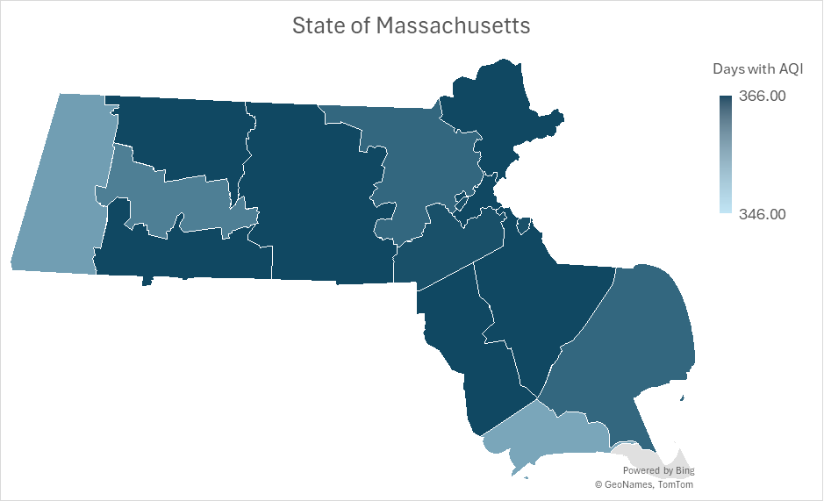
Why These States & Data?
Data Source: U.S. EPA, CDC, Department of Health
Why MA & MN?
Detailed county-level age-adjusted asthma rates
Publicly accessible, clean datasets
County population included for fair comparison
Ensure small yet robust and comparable results

Slide 5
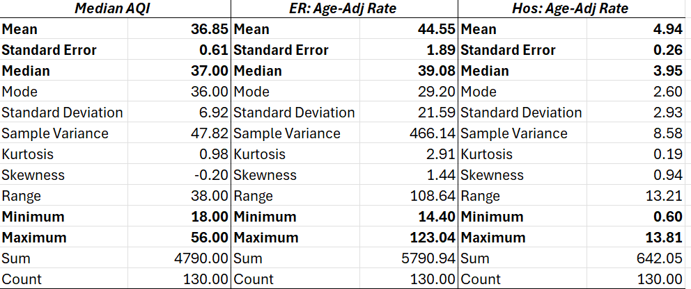
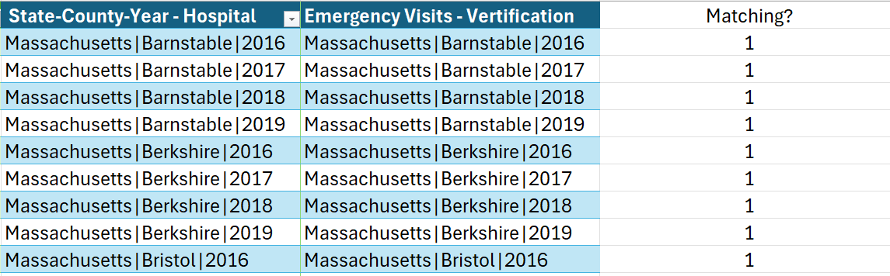
Descriptive Table
130 matched county–year observations (out of 230 total state–county–years data; others missing at least one variable).

Slide 6
Statistical Model & Hypothesis
Asthma Regression Model
Hospitalization Rate: Y₁ = β₀ + β₁(AQI) + ε
ER Visits Rate: Y₂ = β₀ + β₁ (AQI) + ε
Hypothesis
H₀: β₁ = 0
Translation: AQI = no effect on asthma-related rates
H₁: β₁ > 0
Translation: Higher AQI = higher asthma-related rates

Slide 7
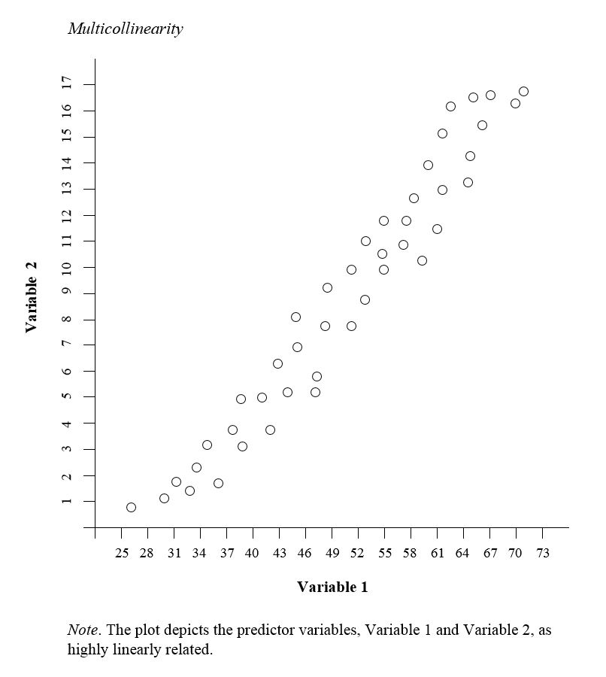
Why Only AQI as Predictor?
Adding other pollutant variables causes multicollinearity!
Adjustment pre-standardizes the data, removing need for age and density variables.
Socioeconomic factors (poverty, smoking) were excluded due to data limitations at the county level.
Image Credit: Wikimedia

Slide 8
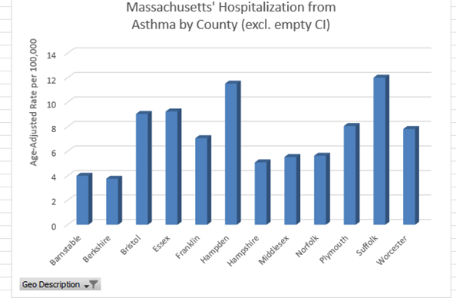
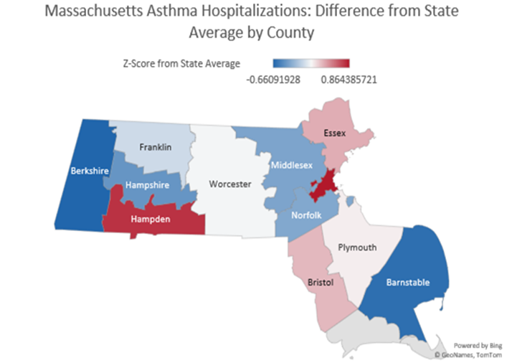
Exploratory MA County-Level Insights
Some counties show notably higher asthma hospitalization rates than the state average, suggesting that local factors (beyond AQI) are driving variation.

Slide 9
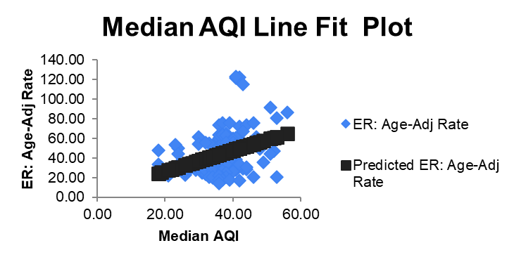
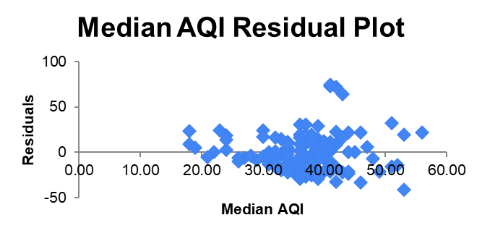
Emergency Visits vs. AQI
Model: Age-adjusted emergency visit rate (per 100k) as a function of median AQI
Slope (β₁): ~1.06
A 1-point increase in AQI is associated with ~1 extra emergency visit per 100,000 people.
95% CI: [0.55, 1.58] → does not include 0 → statistically significant (p ≈ 7∗10⁻⁵).
Adjusted R² ≈ 0.11 → AQI explains about 11% of variation; most variation is due to other factors.

Slide 10
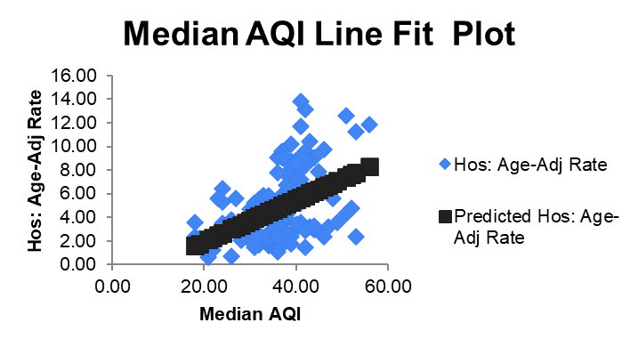
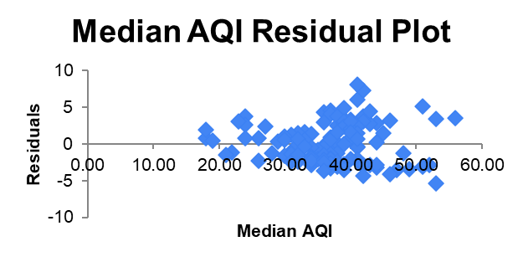
Hospitalization Visits vs. AQI
Model: Age-adjusted hospitalization visit rate (per 100k) as a function of median AQI
Slope (β₁): ~0.18
A 1-point increase in AQI is associated with ~2 extra emergency visit per 1M.
95% CI: [0.11, 0.24] → does not include 0 → statistically significant (p ≈ 8∗10⁻⁷).
Adjusted R² ≈ 0.17 → AQI explains about 17% of variation; most variation is due to other factors.

Slide 11
Summary & Interpretation
- Both regression models produce statistically significant positive coefficients for AQI, meaning higher AQI levels are associated with higher asthma-related emergency visits and hospitalizations.
- R² values are modest (0.11–0.17), indicating that AQI explains only a small portion of asthma variation. This is expected, as asthma is influenced by many other factors.
- Residual plots show heteroskedasticity, suggesting that at higher AQI levels, variation in asthma outcomes increases, and additional independent variables are be needed in a more predictive model.
– Overall, we reject the null hypothesis (β₁ = 0) and accept the alternative hypothesis (β₁ > 0) that air pollution (as measured by AQI) has a statistically significant, positive association with asthma-related health outcomes.

Slide 12
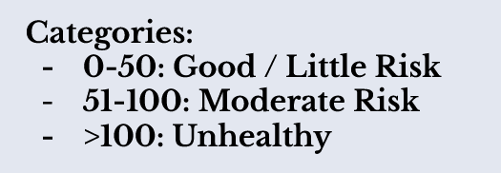
BUT WAIT!

Slide 13
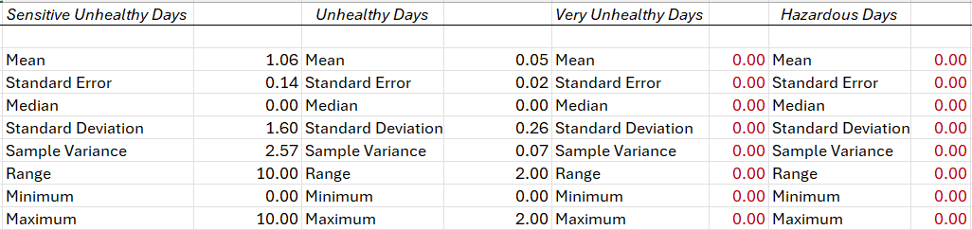
Maybe the frequency of the aggregate of unhealthy days (AQI>100) drive MORE emergency visits than the general median?
Model: Y₁ & Y₂ = β₀ + β₁(AQI > 100) + ε

Slide 14
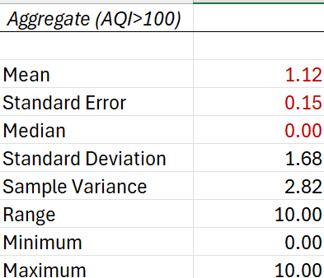
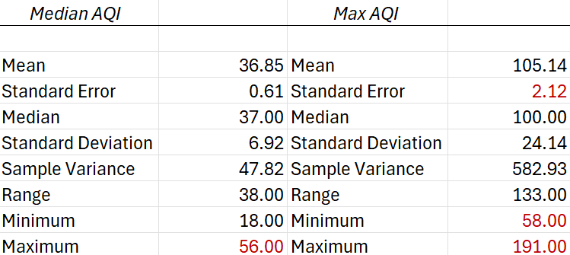
Does spikes in pollution (severity) drive ER and hospital visits more than the median AQI?
Model #2: Y₁ & Y₂ = β₀ + β₁(Max AQI) + ε
Hypothesis: H₀: β₁ = 0 or H₁: β₁ > 0

Slide 15
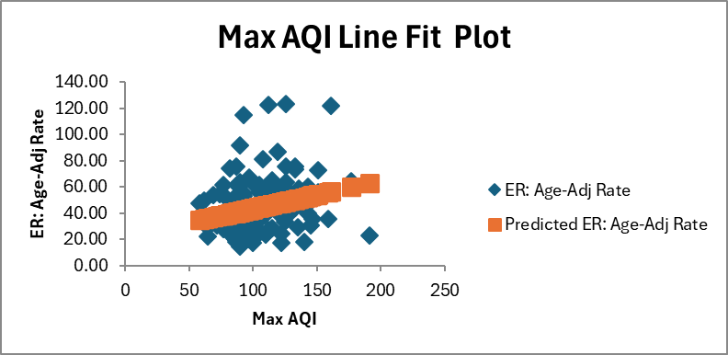
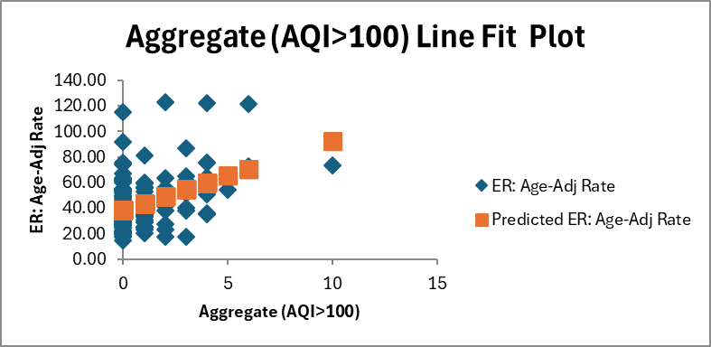
Asthma Emergency Visits Revisited
MAX AQI (Severity)
95% CI of β₁: [0.06, 0.36]
P-value ≈ 6.69∗10⁻³
Adjusted R² ≈ 0.05
Statistically valid
AQI > 100 (Frequency)
95% CI: [3.35, 7.44]
P-value ≈ 6.8∗10⁻⁷
Adjusted R² ≈ 0.17
Statistically valid

Slide 16
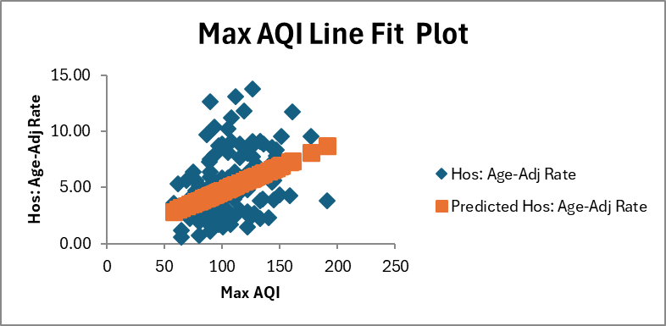
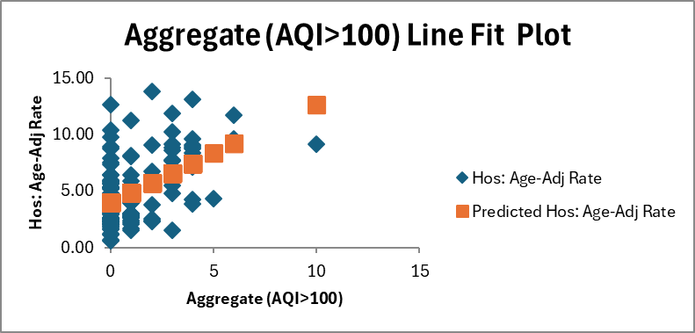
Asthma Hospitalization Revisited
MAX AQI (Severity)
95% CI of β₁: [0.02, 0.06]
P-value ≈ 2.66∗10⁻⁵
Adjusted R² ≈ 0.15
Statistically valid
AQI > 100 (Frequency)
95% CI: [0.61, 1.13]
P-value ≈ 1.62∗10⁻⁹
Adjusted R² ≈ 0.24
Statistically valid

Slide 17
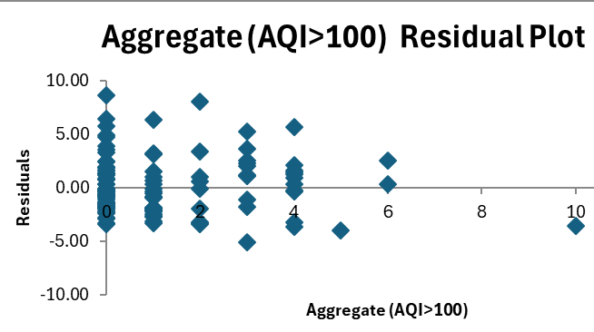
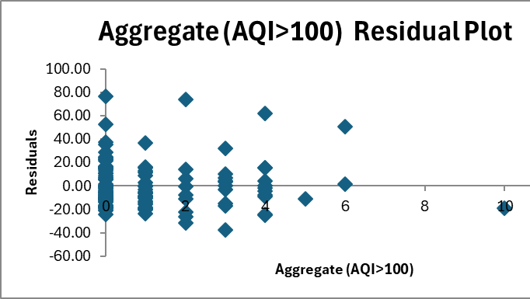
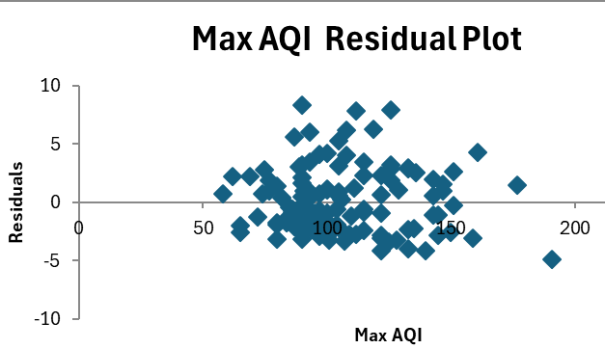
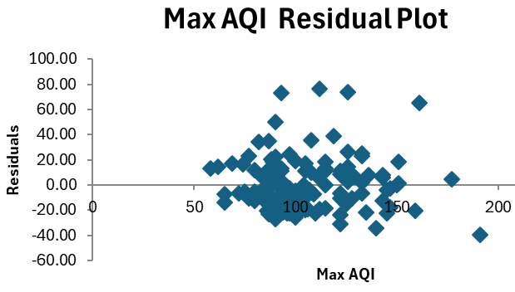
Hospitalization
ER Visits

Slide 18
Final Conclusion
All models are….
statistically significant (p < 0.01)
positive correlated with Y₁ & Y₂
reject H₀ = β₁ = 0
accept H₁ = β ₁ > 0
BUT
Max AQI and AQI > 100 are homoscedastic
Median AQI had slight heteroscedasticity
Adjusted R² | Median AQI | Max AQI | AQI > 100
ER Visits | 0.11 | 0.05 | 0.17
Hospitalization | 0.17 | 0.15 | 0.24
Ranking | Middle | Worse | Best

Slide 19
Pre-Presentation
Teacher-Led Feedback

Slide 20
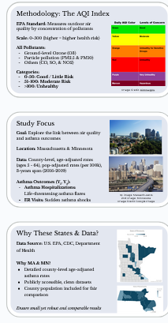
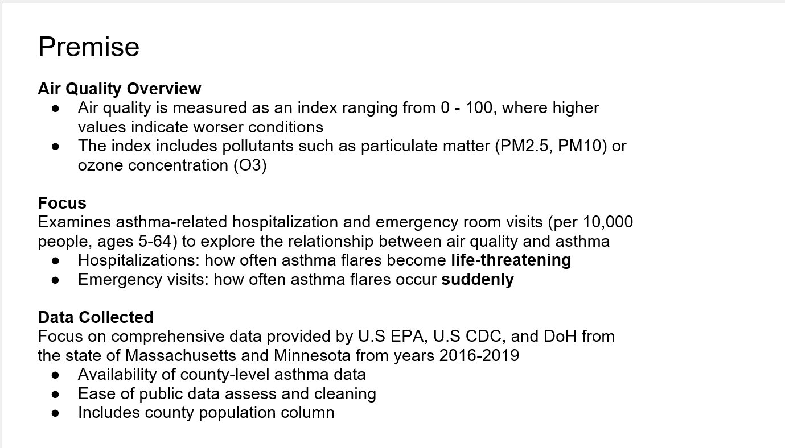
Feedback Credit Slide:
“slide 2 I would split into 2 or 3 slides and increase font.”
How I used the feedback:
(Below) is my old slide 2 where it is just information packed into one slide.
(Right) is my new slides where I split up the information into 3 separate slides and increased font!

Slide 21
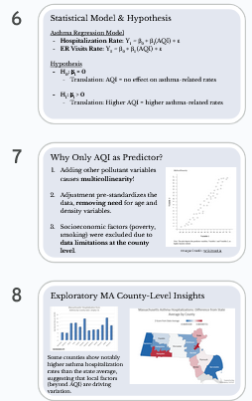
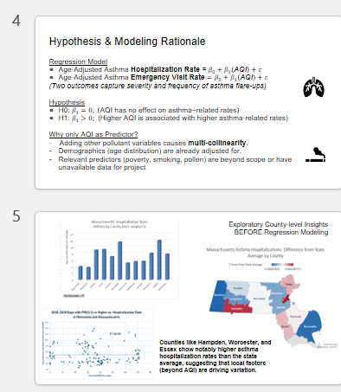
Feedback Credit Slide:
“Same with 4 & 5. you I think that the added slides shouldnʻt take to much long to cover in presentation so could afford to do this.”
How I used the feedback:
(Below) is my old slides 4 & 5 where information is also packed and font size is small.
(Above) is my new slides where I separate information in slide 4 into two slides & deleted a chart for more visual clarity in slide 5

Slide 22
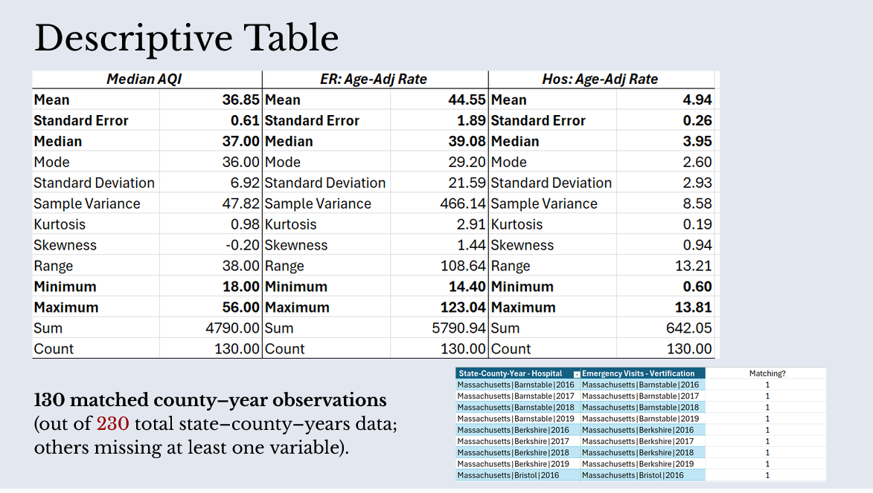
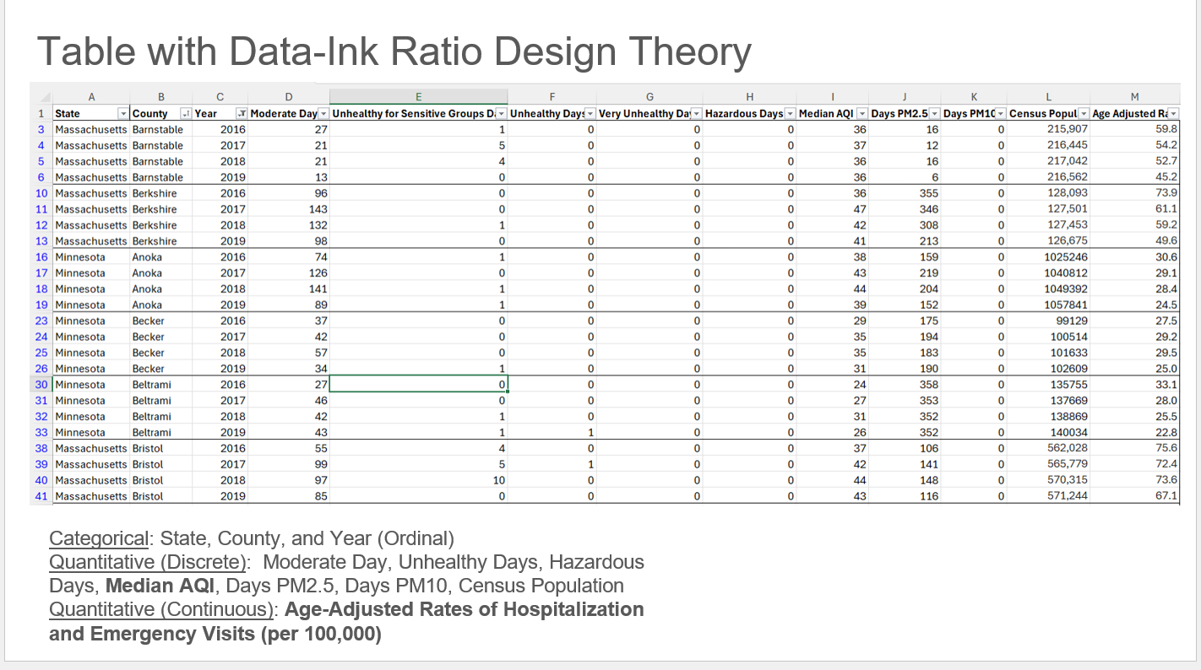
Feedback Credit Slide:
“slide 3 might be better as a descriptive table (found in data where regression option is)”
How I used the feedback:
(Below) is my old slides 3 where there’s a whole lot of columns that doesn’t help the audience understand my regression
(Above) is my new slides where I converted the ink-ratio table into just a descriptive table that shows the 3 variables involved in regression.

Slide 23
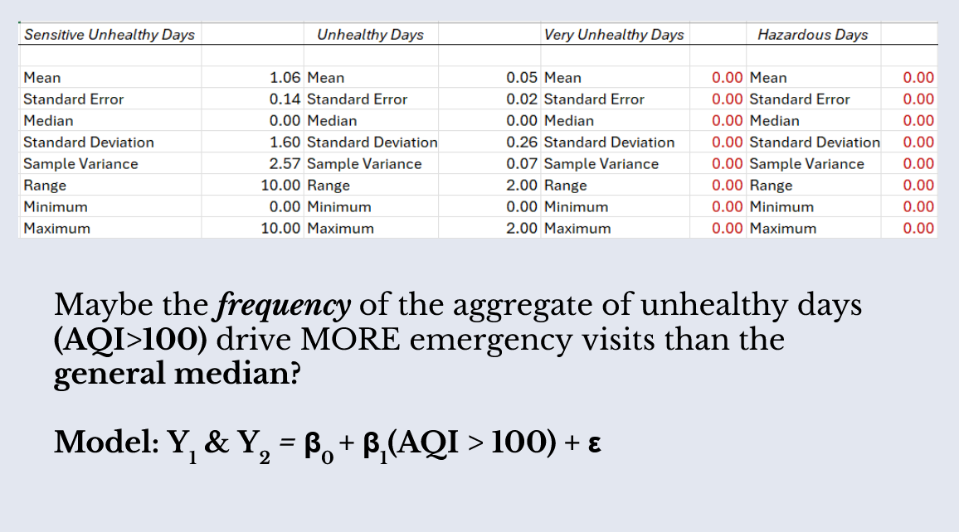
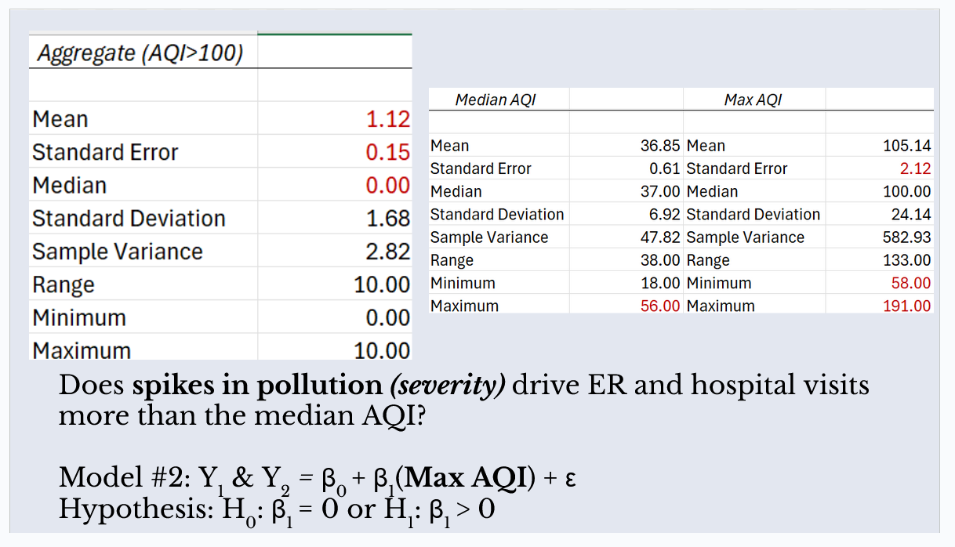
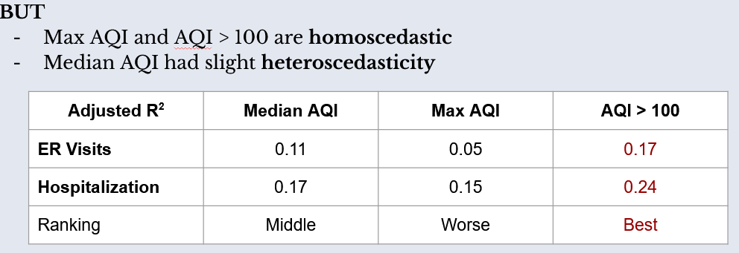
Feedback Credit Slide:
“Regression 6 is cool do you have the data that can use max versus median/mean? Actually looking at 3 Iʻll just jump into sensitivity.
Sensitivity Analysis:
From table it looks like you do have hazardous and very unhealthy. Run this equation:
rates= unheathysen+ unhealthy+veryUnhealth+Hazardous+agerate+e”
I incorporated both max AQI and the frequency of unhealthy days (AQI > 100) into my slides.

Slide 24
Post-Presentation
Student-Led Feedback

Slide 25
Post-Presentation Feedback A:
"Why only use AQI? Factors like smoking, income, and BIPOC status play a huge role. Were impoverished communities disproportionately affected?"

Slide 26
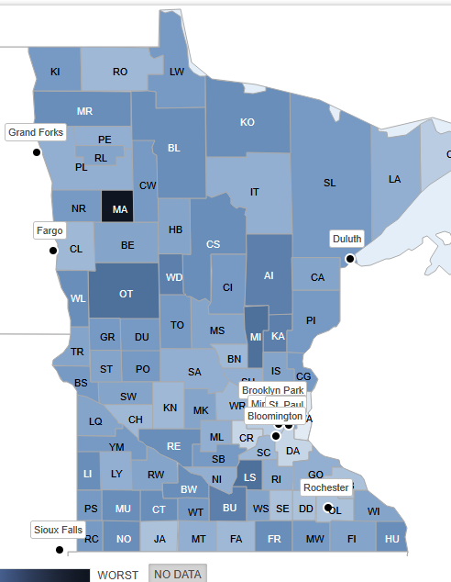
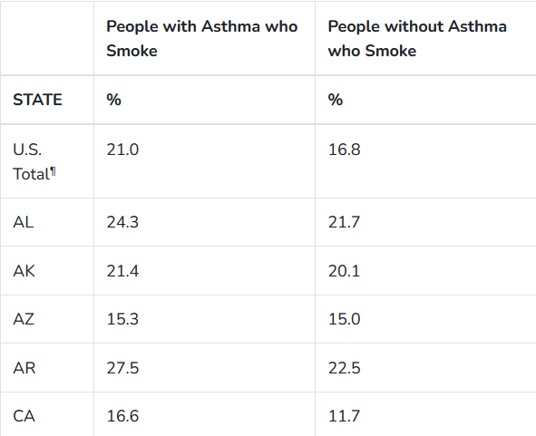
(Part i) Feedback Response – Methodology & Data Constraints
Acknowledgement: As noted briefly in Slide 7, I agree that Socioeconomics Status (SES) and smoking are major confounders.
The Specificity Problem: While county-level smoking data exists (see map), it creates a causation gap. The data does not distinguish between the general population and the specific asthma patient population admitted to the hospital.
Requirement for Causation: To control for this effectively, this model would need private health habits data linking specific habits directly to the patients admitted, which was unavailable in the public datasets for county-level state data. There is, however, from the CDC that has state-level data of % of people with asthma who smoke. I could not say the same in finding readily-available for county-level.
“Socioeconomic factors (poverty, smoking) were excluded due to data limitations at the county level.” – Slide 7
Map Source:
Adult Smoking in Minnesota. (2025). County Health Rankings & Roadmaps. https://www.countyhealthrankings.org/health-data/community-conditions/health-infrastructure/health-promotion-and-harm-reduction/adult-smoking?year=2025&state=27&tab=0
Table Source:
Asthma Stats Percentage of People with Asthma who Smoke People with Asthma (n.d.). U.S. Centers for Diseases Control and Prevention. https://www.cdc.gov/asthma/asthma_stats/asthma_stats_factsheet.pdf

Slide 27

(Part ii) Feedback Response – Theoretical Context
The AQI Overlap: AQI does partially controls for smoking already. According to the National Institute of Environmental Health Sciences (NIHS), cigarette smoke contributes to Particulate Matter (PM) levels, which is the key component of the AQI index used in this model.
Chemical Impact: However, I acknowledge that smoking introduces specific respiratory irritants not fully captured by AQI like lead, tar, nicotine, and formaldehyde, which does directly worsen outcomes for asthma patients (NIHS, 2024).
SES as Proxy Variables: Variables like Income and Race often act as proxies for structural factors, such as housing standards (mold/dust) or proximity to industrial sites (e.g., coal/gas plants). These are environmental factors that I am more interested in as it is the focus of the class.
Scope: However, getting these structural datasets on a county-level basis was not readily available in my search. As this study prioritized environmental factors like specific industrial proximity, so I did not include socioeconomic status variables like income nor race/ethnicity in my analysis.
Oil and gas-power power plant in Massachusetts shown above. According to article, a Japan-based company in 2022 is seeking to repurpose it for offshore wind.
‌Image and article Source:
Mohl, B. (2022, May 12). Japanese firm has different plan for Cape power plants. CommonWealth Beacon. https://commonwealthbeacon.org/uncategorized/japanese-firm-has-different-plan-for-cape-power-plants/
Smoking Source:
National Institute of Environmental Health Sciences. (2024, June 12). Smoking and Vaping. National Institute of Environmental Health Sciences. https://www.niehs.nih.gov/health/topics/agents/smoke
‌

Slide 28
Post-Presentation Feedback B:
Include seasonal effects (seasonality), increase data range to 10-year trends, Climate Change, or COVID-19 impacts

Slide 29

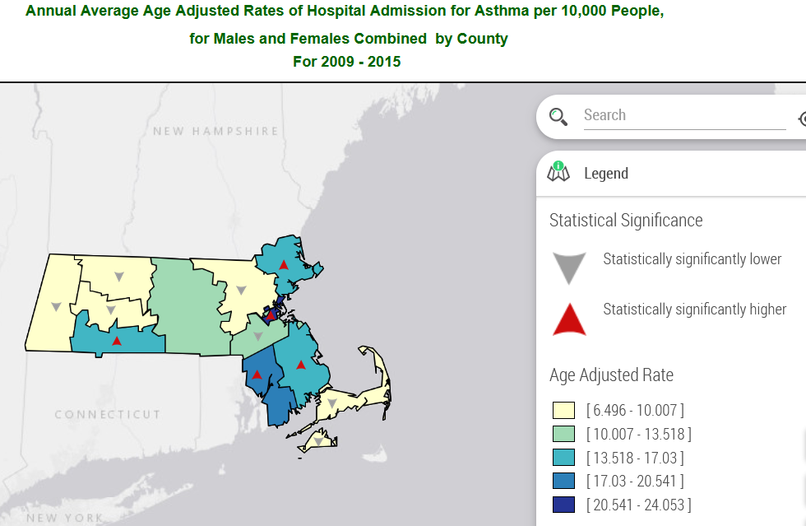
(Part i) Response Feedback – Why 10-year trend is not possible
Data Availability Constraint: This study relies on a comparative analysis between Massachusetts and Minnesota. Currently, the Minnesota Department of Health data portal is offline, making a retrospective comparison impossible for this final submission.
The "ICD-10" Structural Break: Even if data were available as Massachusetts data portal shows, comparing pre-2015 and post-2015 data is statistically invalid due to the October 2015 transition from ICD-9 to ICD-10 medical coding standards. This creates a "History Threat" to validity.
Evidence: The Coding Incompatibility (CDC, 2019)
ICD-9 (Pre-2015): Stratified by trigger (e.g., Extrinsic vs. Intrinsic). Asthma with COPD was often included in the primary asthma count.
ICD-10 (Current): Stratified by severity (e.g., Mild Intermittent vs. Severe Persistent). These conditions are coded separately.
Result: Comparing the two periods would show a sharp increase or drop of asthma rates simply because coding definitions became different, not because air quality suddenly changed in 2016.
Link to Minnesota health data portal website
Link to Massachusetts health data portal website
Map Source:
ICD-9-CM to ICD-10-CM Conversion | CDC. (2019, November 4). Www.cdc.gov. https://www.cdc.gov/asthma/data-analysis-guidance/ICD-9-CM-ICD-10-CM.htm
‌

Slide 30
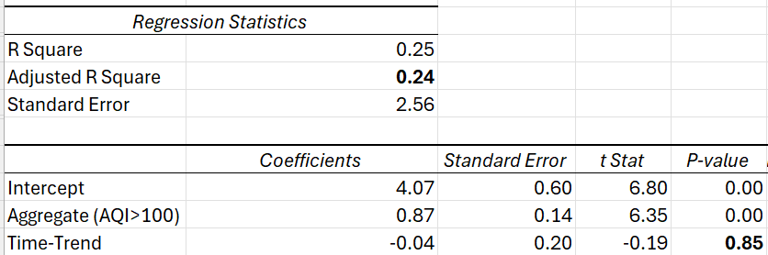
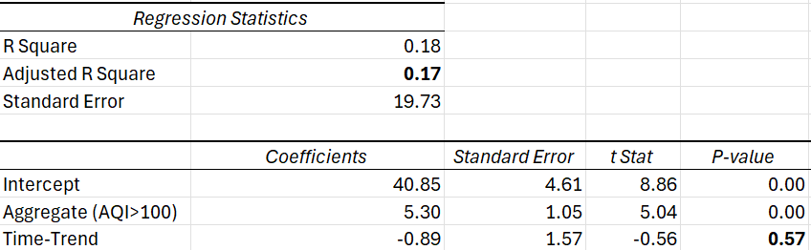
(Part ii) Feedback Response – Control Variables & Data Scope:
Seasonality: Seasonal dummy variables could not be used because the asthma data is aggregated annually and not reported by year and quarter, thus eliminating possibility.
In replacement of seasonality, I controlled unobserved factors over time with a linear time trend (t = 1, 2, 3, 4) by year. Finding: The time trend was statistically insignificant (p>0.05) in both models, indicating that asthma rates were stable over the 2016–2019 period and not driven by another trend.
COVID-19 Exclusion: Years 2020–2021 were deliberately excluded to avoid a structural break in the data as the pandemic fundamentally altered everyday operations and hospital utilization, which would bias the AQI outcomes and asthma relationships observed in normal years. If year 2022, 2023, and 2024 were also available to pull from, then it would allow for a comparison between “normal” and “covid” years.
Climate Change: Climate change impacts require decades-scale data. As this dataset covers only a short-term period (4 years), analyzing long-term shifts was considered out of scope.
(Part I) Hospitalizations
(Part II) Emergency Visits

